Slide 1
Lecture 31
MongoDB

Slide 2
Relational Databases
A database in which application data has been logically placed in tabular form which are often interconnected.

Slide 3
Relational Databases
Student Table
Each row represents an individual record
ID
5
6
7
Name | Roll No. | Program | Address
Arsalan Ahmed | 342343 | BSCS | 109
Muhamed Umer | 342344 | BSBA | 110
Ali Raza | 342345 | MCom | 112
Address Table
ID | Street Addr | City
109 | Jhang Road | F.Abad
110 | Nishat Abad | F.Abad
112 | Johar Town | Lahore
We can use joins to interconnect multiple tables

Slide 4
Advantages of No SQL?
1). Native Support for complex data structures(XML, JSON, Binary)
2). Detachment from sql standardS
3). Mainting nosql servers is cheaper
4). Allows sharding distributing large databases on different servers.

Slide 5
MongoDB (A document based database)
SQL Database represents each record as a row
MongoDB represents each record as a document
SQL Database represents each dataset as a table
MongoDB represents each dataset as a collection

Slide 6
Organizations using MongoDB
LinkedIn
Adobe
McAfee
FourSquare
eBay
MetLife
SAP

Slide 7
MongoDB (A document based database)
MinKey (For sorting purposes)
Null
Numbers (ints, longs, doubles)
Symbol, String
Object
Array
BinData (Used for binary data)
ObjectId (Used for referencing and identifying objects)

Slide 8
Identifying documents
Each object has an ObjectID which can be uniquely generated or manually set.
ObjectID is generated with the following data:
1). 4-byte timestamp
2). 3 byte Machine identifier
3). 2 byte process ID
4). 4 byte random ID

Slide 9
Getting started
Choose the DB to start with
use local (local is a database name)
Create a collection(table) by storing records
db.students.save({name:’Khurram’, city:’F.Abad’})

Slide 10
Getting started
Find a document with name Khurram
db.students.find({name:’Khurram’})
Update a document with name Khurram
db.students.update({name:’Khurram’}, {name:’Khurram Raheel’, age:17})
db.students.update(to match with, update data with)

Slide 11
Getting started
Remove a document with age 17
db.students.remove({age:17});
Remove all documents
db.students.remove()

Slide 12

Mongoose

Slide 13
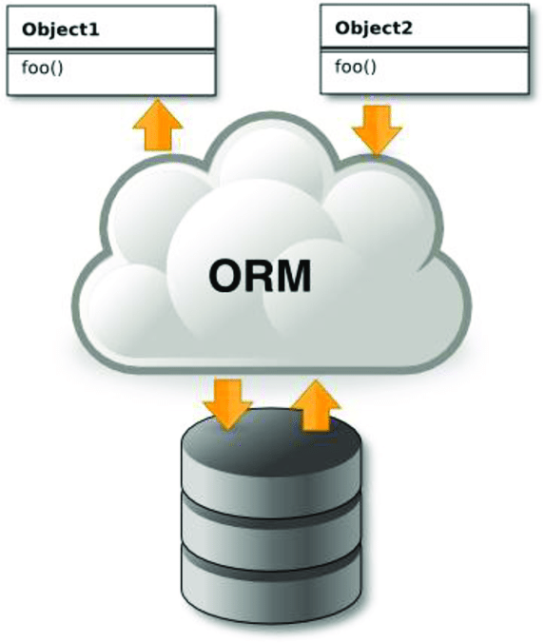
ORM interacts with the database itself
and provides us high level classes for
designing our data model.

Slide 14
Mongoose
Mongoose is a Object Document Mapper based wrapper over core MongoDB to provide developers a robust API for rapid database related operations.
Mongoose allows us to have access to the MongoDB commands for CRUD simply and easily.

Slide 15
Define Schemas (Column Definition in SQL)
Schemas define the basic structure of a document.
var studentSchema = mongoose.Schema({
name:String,
address:{
name:String,
city:String
}
})

Slide 16
Define a model
Models are API abstraction which are derived from the defined Schema.
var Student = mongoose.model(‘Student’, studentSchema);
var student1 = new Student();
var student2 = new Student();
var student3 = new Student();
student1.save(function(err, savedStudent){
})

Slide 17
Adding behavior to a schema
var person = mongoose.Schema({
name:String,
password:String
});
//Add behavior to a schema through the methods object
person.methods.greet = function(){
}

Slide 18
Add dynamic attributes
var personSchema = ongoose.Schema({
firstName:String,
lastName:String
});
Example
var person = new Person();
person.firstName = ‘Khurram’; person.lastName = ‘Raheel’; //person.name //Khurram Raheel
personSchema.virtual(‘name’).get(function(){
return this.firstName + ‘ ‘ + this.lastName;
}).set(function(name){
var fullName = name.split(‘ ‘);
this.firstName =fullName[0]; this.lastName = fullName[1];
});
//person.name = ‘Khurram Raheel’
//person.fullName = ‘Khurram’ //person.lastName = ‘Raheel’

Slide 19
Performing Smart Queries
Running independent query functions
Student.find().where('name').equals('new Record').exec(function(err, students);
Using OR operator in a query
Student.find().or([{enrollment:’CS'}, {enrollment: ‘IT’}])
Using AND operator along with an other operator in a query
Student.find().and([{enrollment:’CS'}, {cgpa: {$gt:3.4}}])

Slide 20
Performing Comparing Queries
Student.find().where(‘age’).gt(22)’

Slide 21
Referencing Documents
var AddresSchema = new mongoose.Schema({
streetNo: String,
city: String,
postalCode
});
var StudentSchema = new mongoose.Schema({
name: String,
email: String,
address:{
type:mongoose.Types.ObjectId,
ref:'Address‘
}
})

Slide 22
Performing Comparing Queries
Student.find().where(‘age’).gt(22)’

Slide 23
Referencing Documents
var AddresSchema = new mongoose.Schema({
streetNo: String,
city: String,
postalCode
});
var StudentSchema = new mongoose.Schema({
name: String,
email: String,
address:{
type:mongoose.Types.ObjectId,
ref:'Address‘
}
})

Slide 24
Remove a document
Student.remove(function(err, student){
});
Student.deleteOne({program:’CS’}, function(err, student){
})

Slide 25
Populating Referenced Documents
Student.find().populate(‘address’).exec(function(err, students){
//Get the fully populated data in here
})

Slide 26
Performing Custom Code Inside a Query
Student.find().$where(function(){
return this.name == ‘Khurram';
});

Slide 27
Skipping and limiting documents
Skip the 1st ten documents (rows)
Student.find({program:’BSCS’}).skip(10)
Select only 15 records
Student.limit(15)
Skip 1st 5 records and select 8 records
Student.skip(5).limit(8)

Slide 28
Sorting documents
Select all students with marks greater than 600 and sort them in ascending order
Student.find({marks:{$gt:600}}).sort({marks:-1});

